Slide 1
#06 Methods, parameters, scope and properties
Notes:
Give an explanation for the concepts method, parameter scope and property
Relevant theoretical decisions
What is a method, when and how is it used?
What kind of methods is common in C# programs?
What is the difference between arguments and parameters?
What is the difference between value and reference parameters?
What is meant by the word scope?
What are properties, how and why are they used or useful?

Slide 2
Methods

Slide 3
Parameters and Arguments

Slide 4
Value and Reference Parameters

Slide 5
Scope

Slide 6
Properties

Slide 7
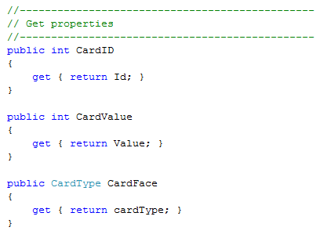
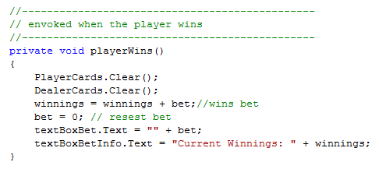
Excerpt from our program
A method within our BlackJackWindow class

Slide 8
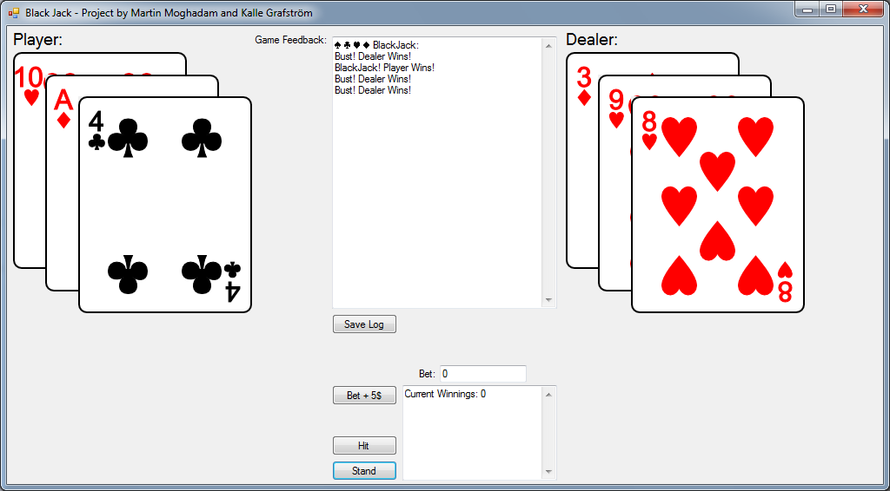
Our program
Black Jack Game
Log
Save Log
Beting
Hit
Stand

Slide 9
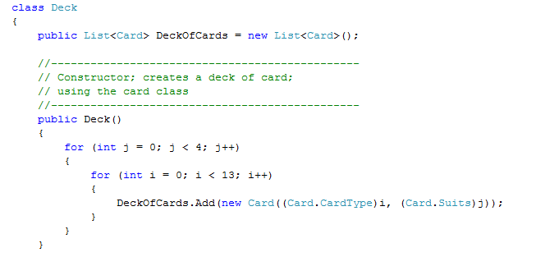
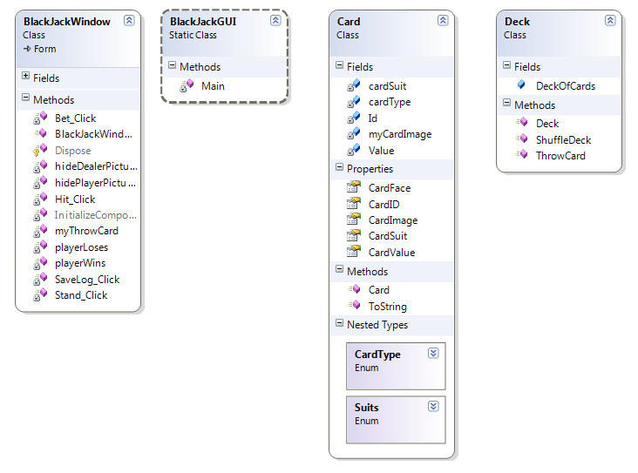
Our program
List and foreach in our application
Notes:
Our application uses list to contain the cards and the foreach statement to manage the cards
Our application contains a simple card class, and a deck class.
A deck of cards is a list that contains objects of the type card.

Slide 10
Questions?

